Slide 1

Knowledge Explorer PDF
Semantic Search and Q&A System for PDF Documents

Slide 2

Introducing Knowledge Explorer PDF : Your Smart Document Assistance
Imagine you have a magic helper that reads all your PDF files and helps you find answers to your questions. You just upload a PDF, type your question, and it magically looks through the document to find the perfect answers. It's like having a super-smart friend who knows everything about your files.

Slide 3
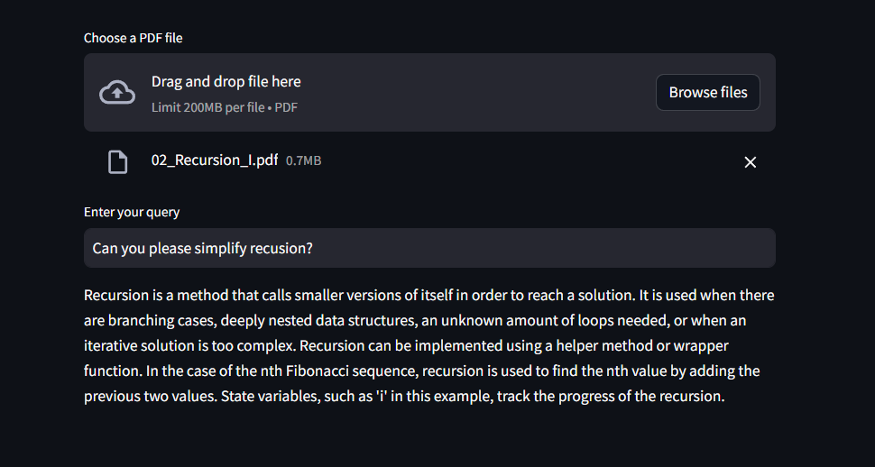

System Overview : How it works?
PDF Upload: Users select a PDF file for analysis.
Question Input: Users input their questions via the user-friendly interface.
Semantic Search: GPT-3.5-turbo processes the query, searches through the PDF context, and generates accurate responses.
Streamlit Presentation: The results are presented in real-time through the Streamlit interface.

Slide 4

Technology Stack
OpenAI GPT-3.5-turbo: Powers the system's semantic search capabilities, enabling contextual understanding and generation of accurate responses.
Streamlit: The user interface is built using Streamlit, a Python library for creating interactive web applications, ensuring a smooth and intuitive user experience.
PyPDF2: Utilized for PDF file handling, PyPDF2 assists in extracting text from uploaded PDF documents.
Python: The entire system is developed in Python, providing a robust and versatile programming environment.

Slide 5

Security Measures
GPT-3.5-turbo, like other models from OpenAI, is designed with security in mind. OpenAI takes measures to protect user data and ensure the privacy and security of the information processed by the models. However, it's crucial to consider certain factors when implementing GPT-3.5-turbo with organization’s data

Slide 6
Next Step

Slide 7

Use Case
Customer Support Knowledge Base: Integrate the system into their customer support platforms, allowing users to ask questions and receive relevant answers from product manuals or support documentation
Technical Documentation Inquiry: Developers or technical writers can use the system to inquire about specific details in technical documentation, making it easier to find and understand complex information
Document Summarization: Users can utilize the system to summarize lengthy documents. By asking targeted questions

Slide 8

Proof of Concept
Demonstration

Slide 9

Q&A and Feedback
Open for questions and feedback

